Slide 1

AI-Powered Smart Newsroom
Youm7 Media Group — Digital Transformation Strategy for Editorial, Fact-Checking, SEO Optimization & Automated Publishing
BOARD OF DIRECTORS & EXECUTIVE EDITORIAL LEADERSHIP

Slide 2










EXECUTIVE ENGAGEMENT SUMMARY
Presentation Agenda & Structure
Industry & Organization Selection
Conceptual Solution Architecture
Industry Selection, Business Challenge & Empirical Evidence
Multi-layer PaaS design, RAG engine & Headless CMS integration.
Business Problem Diagnosis
Business Case & Financial Appraisal
5 Whys root cause analysis & current-state workflow mapping.
3-year TCO, ROI valuation & payback period calculations.
Technology Opportunity Exploration
Phased Implementation Roadmap
Evaluation of Digitize, Digitalize & Transform approaches.
Structured 9-month rollout schedule & milestone delivery.
Technology Fit Decision Matrix
Risk Management & Ethical Governance
Weighted evaluation, trade-off analysis & AI model sourcing.
Hallucination safeguards, data privacy & policy drift controls.
Recommended Integrated Solution
Strategic KPI Performance Dashboard
AI-Powered Smart Newsroom post-consolidation workflow.
Executive performance scorecard & business value metrics.

Slide 3
PART 1: INDUSTRY, CHALLENGE & EVIDENCE
Market Evidence & Problem Validation
Empirical telemetry demonstrating systemic revenue loss, publishing drag, and scale exposure.
Search Volatility
Editorial Drag
Scale Pressure
Google Search Central & Similarweb
WAN-IFRA Newsroom Report
Reuters Institute Digital Report
Helpful Content and Core Web Vitals algorithms heavily penalize latency. Breaking news that exceeds the 10-minute threshold loses Google carousel visibility to digital aggregators.
Senior editorial capacity is drained by manual syntax fixes, disconnected metadata tagging, and fragmented drafts, creating structural bottlenecks across the central review desk.
High-volume digital publishing requires instant speed-to-notify and high factual integrity. Manual workflows fail to scale under the daily load of breaking national coverage.
-65%
ORGANIC REACH LOSS
(DELAY >15 MIN)
>60%
SENIOR BANDWIDTH SUNK
IN ROUTINE QA
600+
DAILY ARTICLES
CENTRAL DESK LOAD

Slide 4
The Challenge: Speed, Accuracy & Visibility
Youm7 Media Group — a leading MENA digital news platform publishing 600+ pieces daily — faces critical operational bottlenecks in verification, SEO, and editorial quality.
180min
42%
Time-to-Publish
SEO Failure Rate
Manual cycle; target: under 40 min
Articles failing to rank on Google
18%
65%
Post-Publication Errors
Readership Loss
Articles requiring post-hoc revisions
When breaking news is delayed 15+ min

Slide 5









Process: Article queue backlogs & fragmented draft versioning.
PART 2: ROOT CAUSE ANALYSIS
Root Cause Analysis & Stakeholder Impact
Root Cause Breakdown (Fishbone > 5 Whys)
Stakeholder Impact Analysis
Process
Technology
Reporters & Correspondents
Article queue backlogs & fragmented draft versioning across disconnected files.
Isolated legacy word processors completely disconnected from the primary CMS.
Delayed publishing & zero visibility into draft modifications during editorial review.
Desk & Copy Editors
Data
People
Relentless workload pressure & cognitive fatigue under tight shift deadlines.
Lack of automated semantic linking with archives & real-time analytics engines.
Senior editorial bandwidth drained by routine copyediting & basic grammar fixes.
SEO & Marketing Leaders
Ongoing friction enforcing search engine compliance across manual editorial workflows.
Board of Directors
Direct revenue losses stemming from diminished organic traffic & lost breaking scoops.

Slide 6
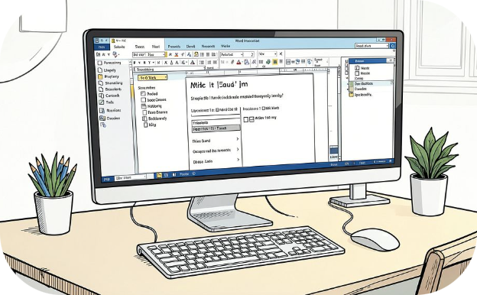

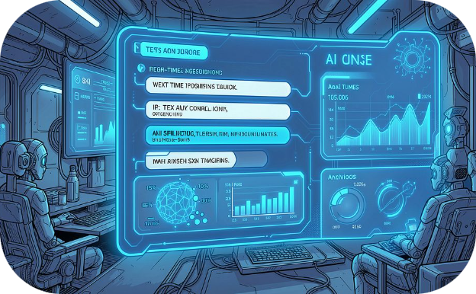
PART 3: TECHNOLOGY OPTIONS
Three Paths Forward
Digitize
Digitalization
Digital Transformation
Automate review cycle as-is. Reduces handover latency by 25% — but cognitive burden stays on editors.
Upgrade tools (Grammarly, etc.). Cuts errors by 30% — but lacks news context or SEO automation.
AI-augmented platform. Reduces lead time 65%, doubles SEO efficiency, boosts productivity 50%+.

Slide 7
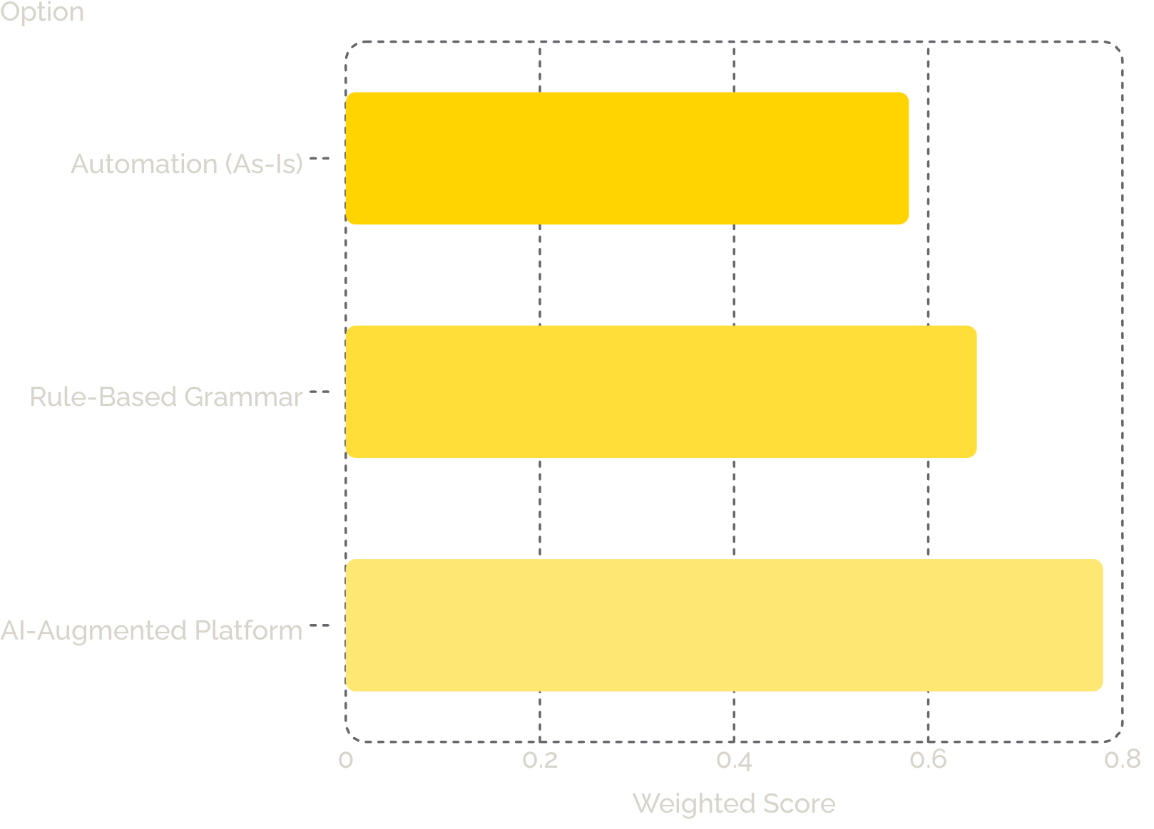

PART 4: EVALUATION
AI-Augmented Platform: The Clear Winner
Why Option 3 Wins
Scoring 78% across 10 weighted criteria, the AI-Augmented Platform is the sole solution capable of transforming publishing lead time, SEO benchmarks, and digital revenue.
Recommended AI Sourcing: Open-source fine-tuning on bilingual foundation models — optimal ROI with zero third-party token costs. Deployed via PaaS (Azure AI / AWS SageMaker) for full data control.

Slide 8

PARTS 5 - 6: ARCHITECTURE
Post-Consolidation Operating Structure
Field Reporter
AI Engine
Desk Editor
Section Head
Human-in-the-Loop is enforced at every stage — no AI suggestion reaches production without explicit editorial approval. Architecture layers: Presentation (Editorial UI), Orchestration (Workflow Engine + API Gateway), AI & RAG Engine (Domain-Adapted LLMs + Vector DB), and Integration (Headless CMS Connector).

Slide 9
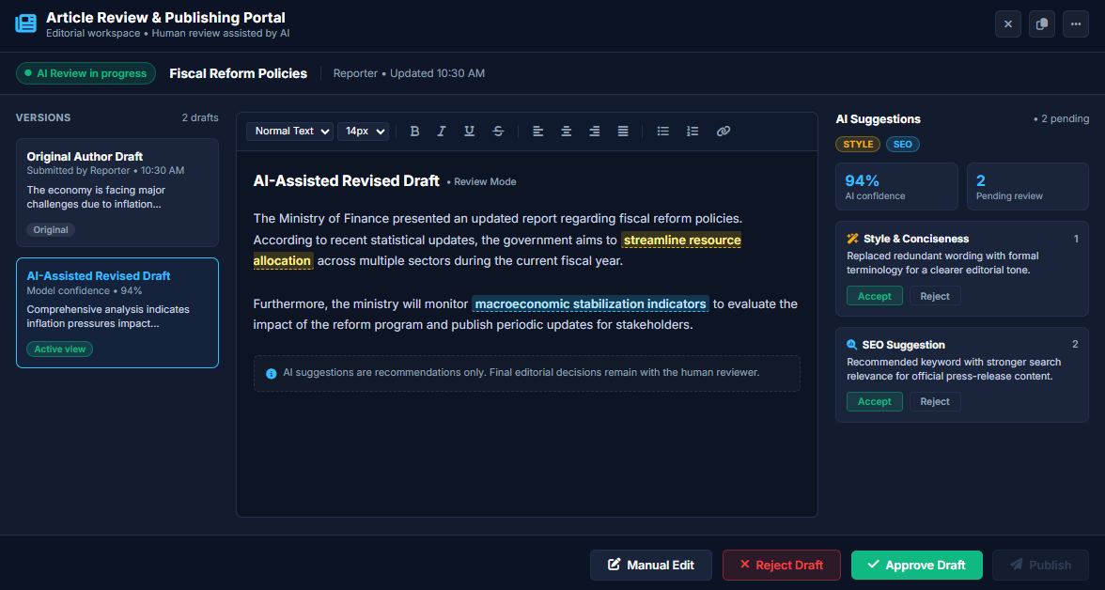
PROTO TYPE
AI-Augmented Editorial Workspace

Slide 10
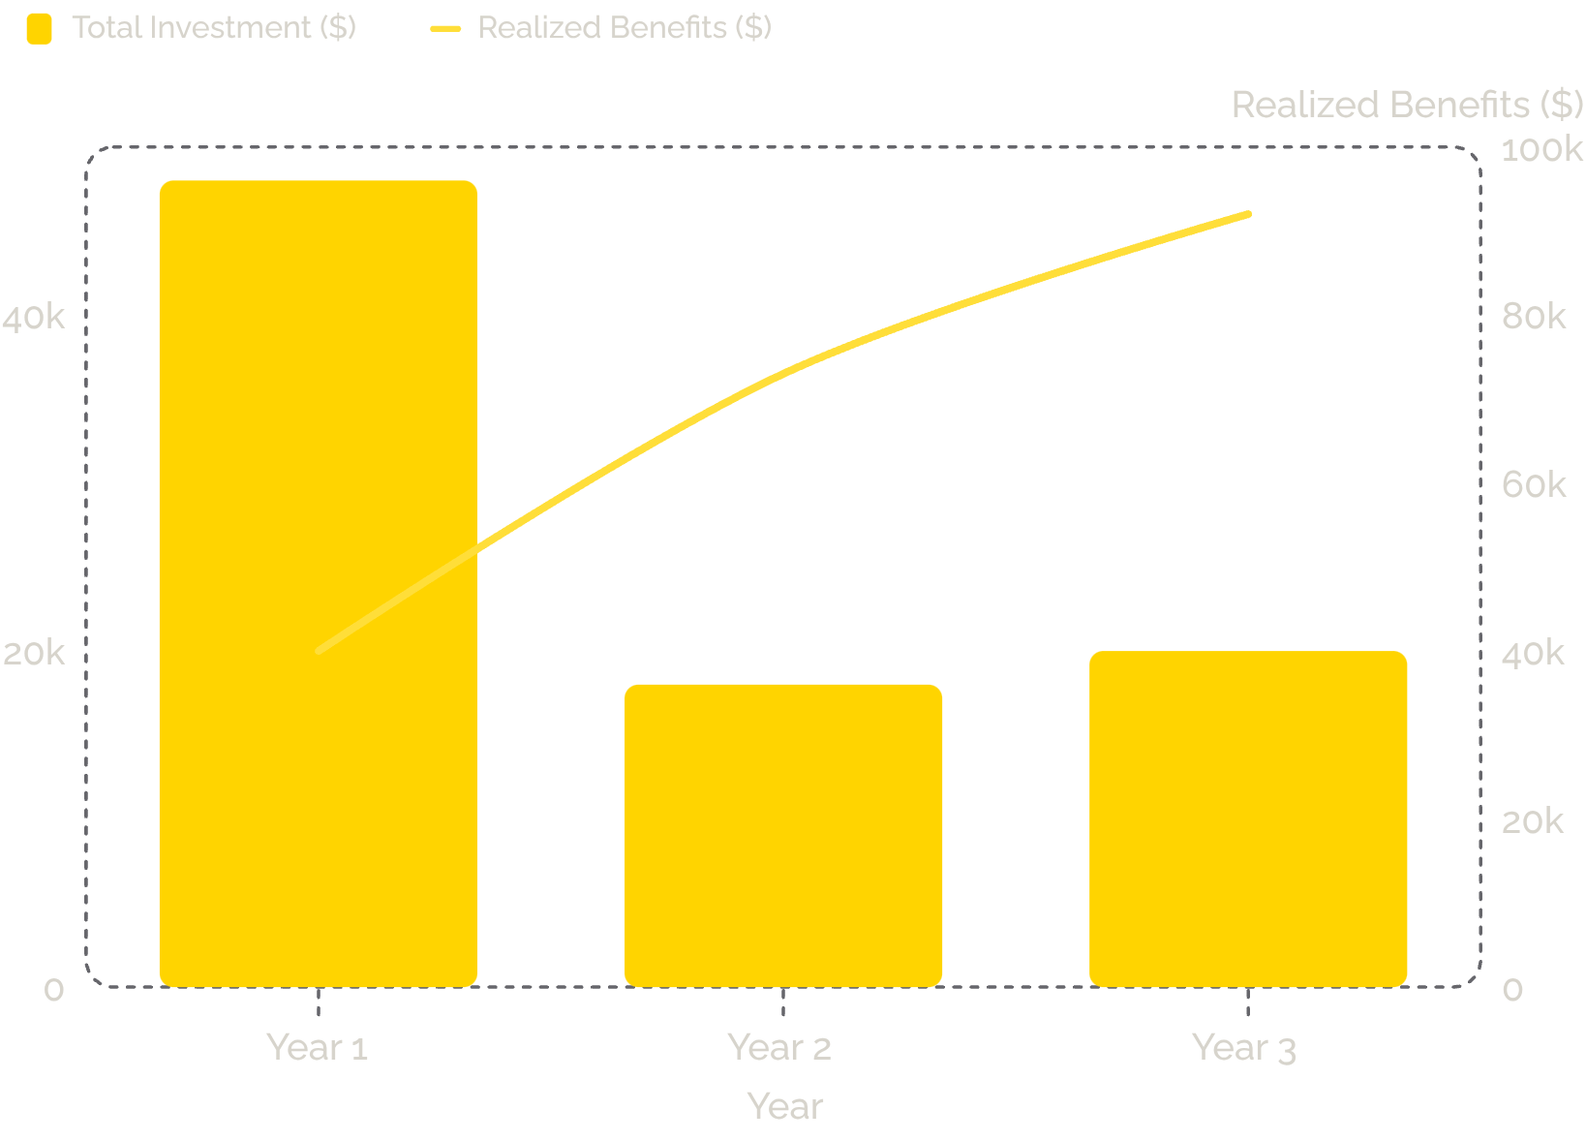
PART 7: FINANCIALS
3-Year Investment Appraisal
Payback period: 13.75 months (Q1 Year 2). Savings driven by editorial labor efficiency ($116K) and SEO-driven ad revenue ($89K) over 3 years.
3-Year TCO
Total Benefits
Net Benefit
ROI
$86,000
$205,000
+$119,000
138.4%

Slide 11
PART 8: ROADMAP
Phased Implementation: 9-Month Rollout
Phase 1 · Months 1–2
1
Provision PaaS cloud, cleanse historical archives, select and benchmark open-source foundation model.
2
Phase 2 · Months 3–4
Fine-tune LLM on newsroom style and SEO taxonomies; build rich-text editor with AI side-panel.
Phase 3 · Months 5–6
3
Connect to Headless CMS via secured APIs; launch single-section pilot; validate hallucination guardrails.
4
Phase 4 · Months 7–9
Enterprise-wide cutover, role-specific Human-in-the-Loop training, drift detection and SLA reporting.

Slide 12


PART 9: RISK & GOVERNANCE
Risk Management & Ethical AI Framework
AI Hallucination — Critical
Data Privacy — High
Strict RAG grounding against verified archives; mandatory Human-in-the-Loop sign-off before any content publishes.
Tenant-isolated Private Cloud PaaS with TLS 1.3 / AES-256 encryption; zero-retention policy preventing third-party ingestion.
Workforce Adoption — High
Editorial Bias & Policy Drift — Medium
Positioned as an "Augmented Workspace" — eliminating repetitive tasks, not replacing roles. Hands-on training and change management workshops.
Supervised fine-tuning on stylebook corpora; scheduled quarterly prompt and model weight re-calibrations.

Slide 13
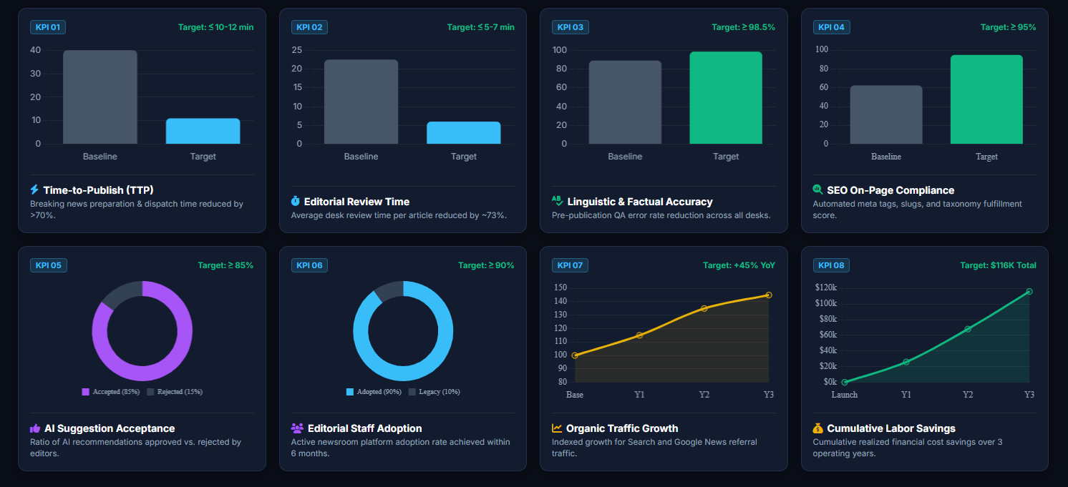
PART 10: KPIs
Strategic & Operational KPI Dashboard

